Slide 1
2-3 Tree and B Tree
Course : COMP6048 – DATA STRUCTURE
Year : 2017

Slide 2
Learning Outcomes
At the end of this session, student will be able to:
Ilustrate construction process of 2-3 Tree (LO1 & LO3)

Slide 3
Sub Topics
2-3 Tree and B Tree
2-3 Tree Concept
Properties
2-3 Tree Operation: Search, Insertion and Deletion
B-Tree Concept
Properties
B Tree Operation: Search, Insertion and Deletion

Slide 4
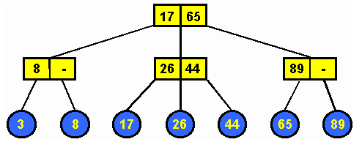
2-3 Tree Concept
2-3 Tree is a tree data structure where every node with children has either two children and one data or three children and two data.
2-3 Tree is NOT a binary tree.

Slide 5
2-3 Tree Properties
Each internal node (non leaf) is either a 2-node or a 3-node.
2-node : has one data and two children (left and middle child)
3-node : has two data and three children (left, middle and right child)
All data are kept in sorted order.
Let A be the data stored in a 2-node. Left sub-tree should contain data less than A, middle sub-tree should contain data greater than A.
Let A and B the data stored in a 3-node. Left sub-tree should contain data less than A, middle sub-tree should contain data greater than A and less than B, right sub-tree should contain data greater than B.
All leaves are at the same level (the bottom level).

Slide 6
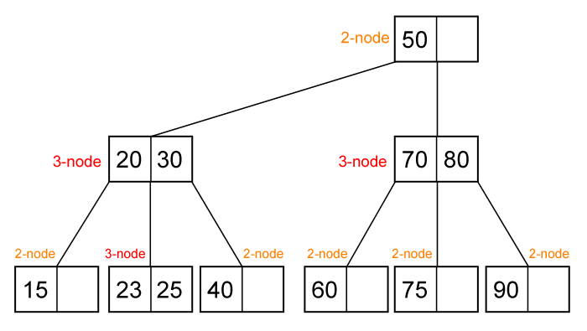
2-3 Tree : Example

Slide 7
Operations: Search
Because all data in 2-3 tree are stored in sorted order, searching in 2-3 tree is easy. We can extend the search algorithm for binary search tree to obtain the search algorithm in 2-3 tree.
find(ptr, x)
If ptr is NULL then not found
If x = A then found
If x < A then find(ptr->left, x)
If ptr is 3-node
If x = B then found
If A < x and x < B then find(ptr->middle, x)
If B < x then find(ptr->right,x)

Slide 8
Operations: Insertion
Supposed we want to insert a new data key.
First we should find where key should be placed in 2-3 tree using search algorithm, it will be in one of the leaf.
If the leaf is 2-node then simply put the new key there (so it’s become a 3-node).
If the leaf is already a 3-node push the middle data between A, B and key (A and B are two data in that 3-node) to its parent and split the two remaining data into two 2-node. Recursively fix the parent.

Slide 9
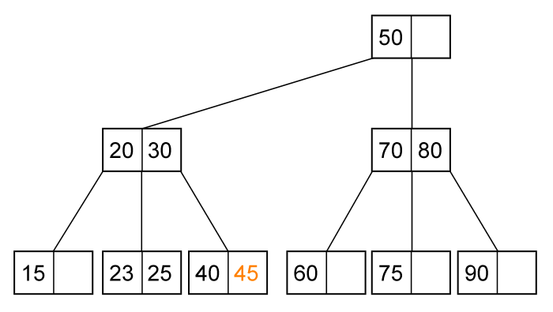
Operations: Insertion - Example
Insert (45). The leaf is a 2-node, just put (45) there.

Slide 10
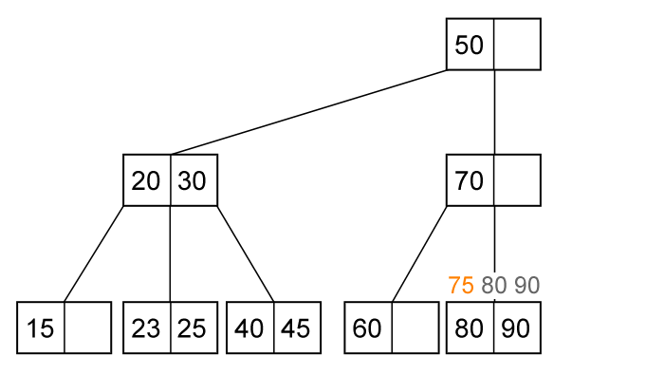
Operations: Insertion - Example
Insert (75). The leaf is a 3-node.

Slide 11
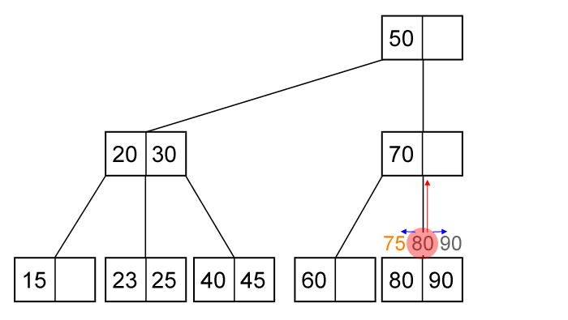
Operations: Insertion - Example
Push the middle value (80) to its parent and split 75 with 90.

Slide 12
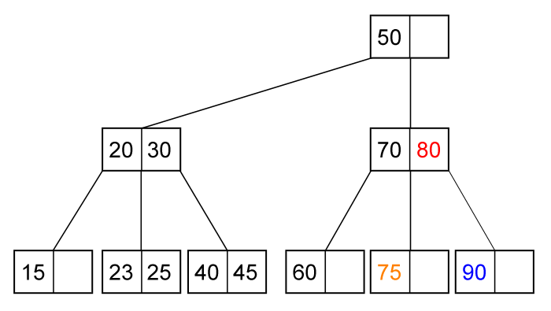
Operations: Insertion - Example
2-3 tree after insertion of (75)

Slide 13
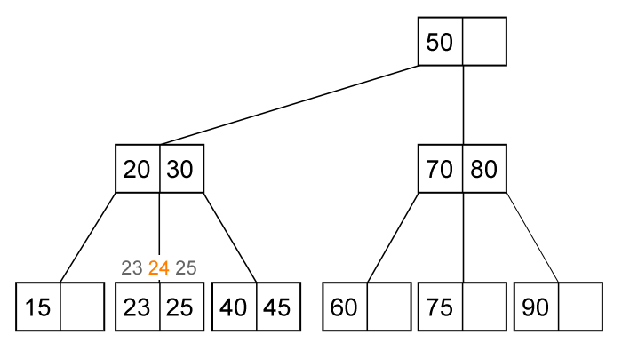
Operations: Insertion - Example
Insert (24). The leaf is 3-node. Push the middle value (24) to its parent.

Slide 14
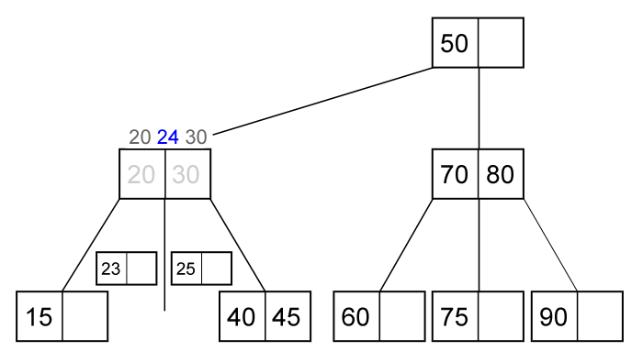
Operations: Insertion - Example
Its parent is also a 3-node. Push the middle value (24) to its parent.

Slide 15
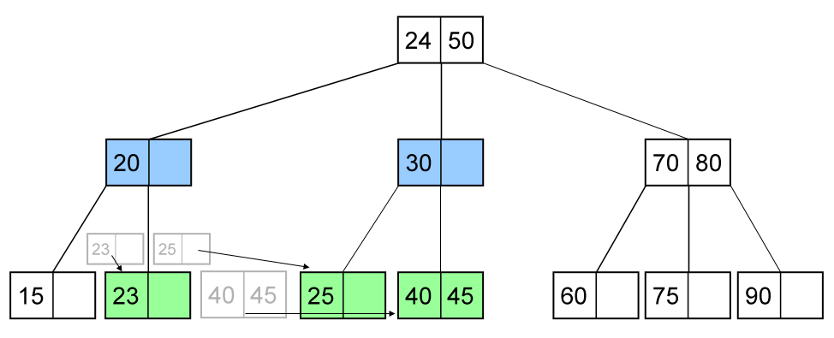
Operations: Insertion - Example
2-3 tree after insertion of (24)

Slide 16
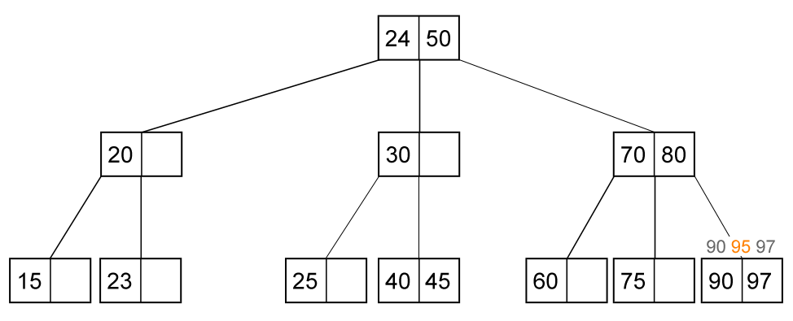
Operations: Insertion - Example
Insert (95). The leaf is a 3-node. Push the middle value (95) to its parent.

Slide 17
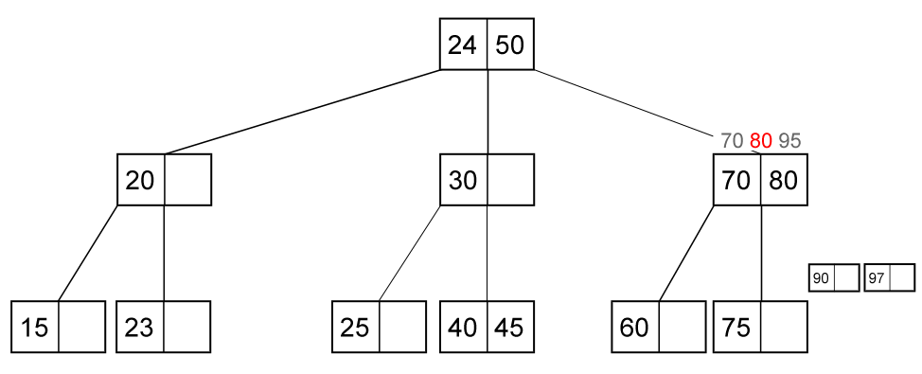
Operations: Insertion - Example
Its parent is also a 3-node. Push the middle value (80) to its parent.

Slide 18
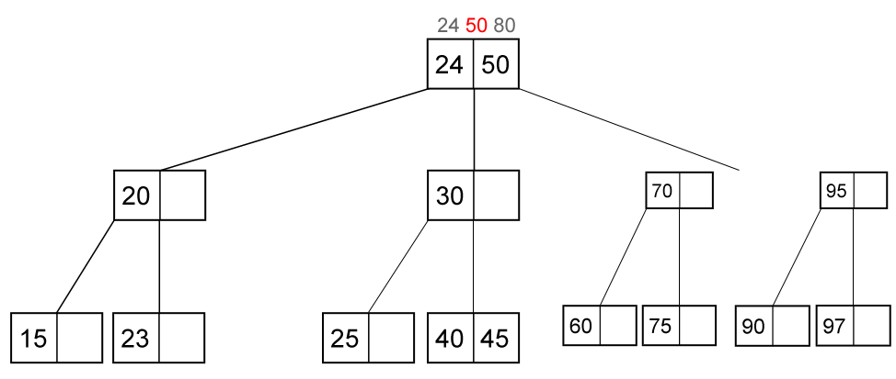
Operations: Insertion - Example
The root is also a 3-node. Push the middle value (50) to be a new root.

Slide 19
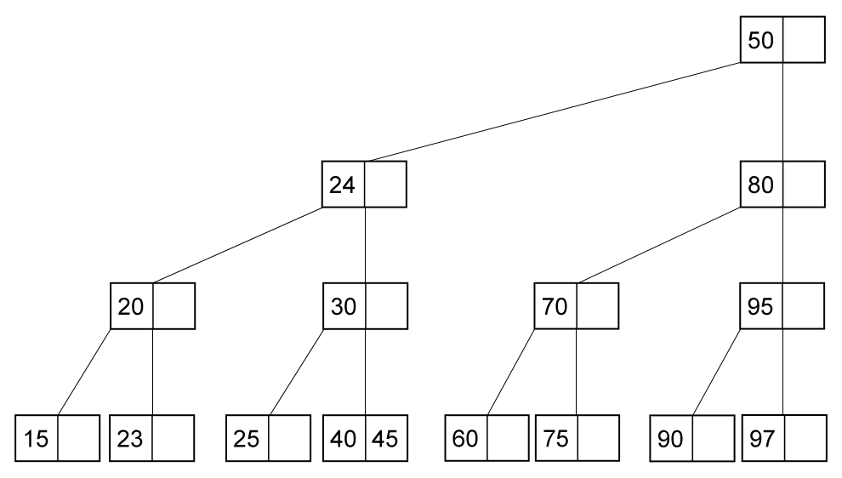
Operations: Insertion - Example
2-3 tree after insertion of (95)

Slide 20
Operations: Deletion
Supposed we want to delete a key from 2-3 tree.
Like in BST, we should find a leaf key which can replace key we want to delete. It means deletion always occurs in a leaf node.
If the leaf is a 3-node, then delete the key so it becomes a 2-node.
If the leaf is a 2-node:
If parent is 3-node, get one value from it. If sibling is a 3-node, push one value of its sibling to the parent (to make the parent 3-node again). If the sibling is a 2-node, make the parent a 2-node and merge current node with its sibling.
If parent is 2-node. If sibling is a 3-node then get one value from parent and push one value from sibling to its parent. Else merge parent with sibling.
Fix parent recursively.

Slide 21
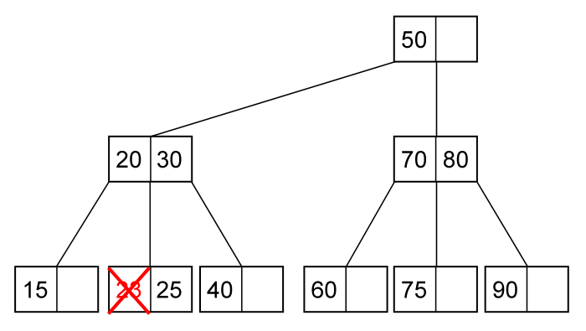
Operations: Deletion - Example
Delete (23). The node is at leaf and the leaf is 3-node. Just delete it.

Slide 22
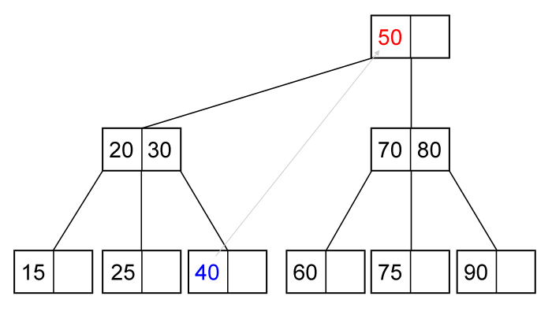
Operations: Deletion - Example
Delete (50). Replace (50) with (40), and delete (40) at the leaf (a 2-node).

Slide 23
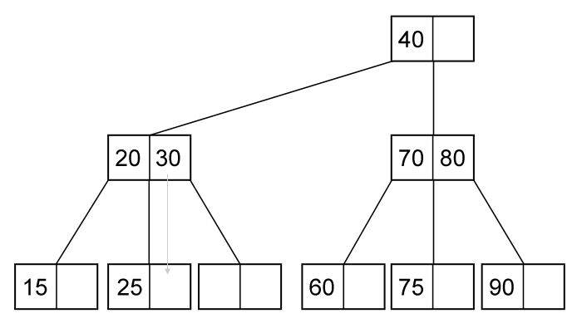
Operations: Deletion - Example
Parent is a 3-node but sibling is 2-node. Merge (25) and (30).

Slide 24
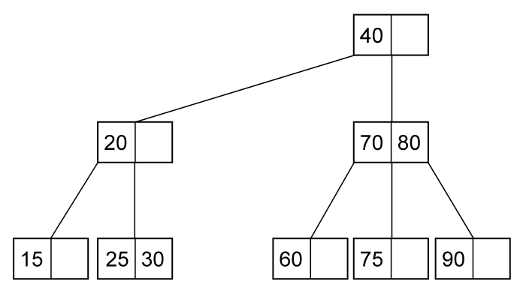
Operations: Deletion - Example
2-3 tree after deletion of (50)

Slide 25
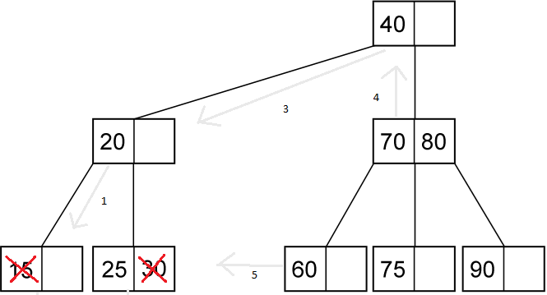
Operations: Deletion - Example
2-3 tree after deletion of (30) and (15)

Slide 26
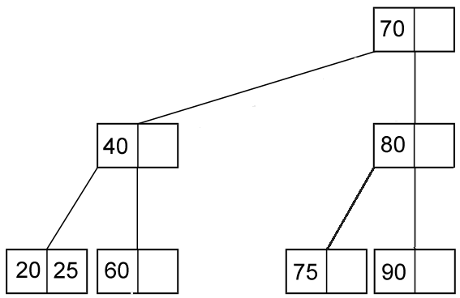
Operations: Deletion - Example

Slide 27
2-3 Tree Review
2-3 Tree is a tree data structure where every node with children has either two children and one data or three children and two data
2-3 Tree is NOT a binary tree.
Each internal node (non leaf) is either a 2-node or a 3-node
All data are kept in sorted order
All leaves are at the same level (the bottom level)

Slide 28
B-Tree
B-Tree is a generalized version of 2-3 tree where each node can store up to m data.
B-Tree is useful when the data are quite large and not fit in memory. B-Tree can store many data in one node, so the height of the tree will be quite small, which mean the number of retrieval data will be small.
Several DBMS (e.g. MySQL, SQL Server) implements B-Tree.

Slide 29
Properties of B-Tree
B-tree of order m has the following properties:
Every node has at most m children.
Every node (except root) has at least m/2 children.
The root has at least 2 children if it is not a leaf.
A non leaf node with k children contain k-1 keys.
All data are kept in sorted order.
All leaves are at the same level (the bottom level).

Slide 30
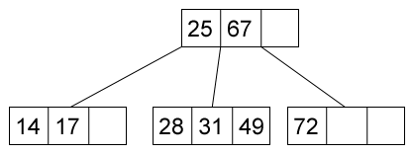
B-Tree : Example (order 4)

Slide 31
Operations: Search
Searching in B-Tree holds the same principle as in 2-3 tree.
find(ptr, x)
if ptr is NULL then return not found
if x < ptr->data[0] then find(ptr->child[0], x)
if x = ptr->data[0] then return found
for i = 1 to m do
if ptr->child[i] is not NULL
if x = ptr->data[i] then return found
if ptr->data[i-1] < x and x < ptr->data[i] then
return find(ptr->child[1], x)
if ptr->data[m] < x then return find(ptr->child[m], x)
return not found

Slide 32
Operations: Insertion
Supposed we want to insert a new data key.
First, we should find where key should be placed in B-tree using search algorithm, it will be in one of the leaf.
If the leaf contain less than m-1 data then insert the new key there.
Otherwise, push the middle data to its parent and split the left side and right side of the middle data. Recursively fix the parent.

Slide 33
Operations: Insertion – Example (order 5)
Insert (k)
Insert (a)
a
f
full, split
a b
g k
Insert (b)
a b
Insert (d)
f
Insert (f)
a b f
a b d
g k
Insert (h)
Insert (m)
f
Insert (g)
a b f g
a b d
g h k m

Slide 34
Operations: Insertion – Example (order 5)
f
a b d
g h k m
+j
f j
a b d
g h
k m
+e, +s, +i, +r
f j
a b d e
g h i
k m r s

Slide 35
Operations: Insertion – Example (order 5)
f j
a b d e
g h i
k m r s
+x
f j r
a b d e
g h i
k m
s x
+c, +l, +n, +t, +u
c f j r
a b
d e
g h i
k l m n
s t u x

Slide 36
Operations: Deletion
Supposed we want to delete a key from B-tree.
Find a leaf key which can replace key we want to delete. It means deletion always occurs in a leaf node. Let the leaf named p.
If the size of p > m/2, then delete it.
If the size of p = m/2, then:
Let its sibling be q.
If size of q > m/2, then rotate the value to p (via its parent).
If size of q = m/2, merge p and q (and one key from its parent).
Fix parent recursively.

Slide 37
Operations: Deletion - Example
-h, -r
j
replaced by a key in leaf
c f
m r
m s
n>m/2
a b
d e
g h i
k l
n p
s t u x
g i
t u x

Slide 38
Operations: Deletion - Example
sizeof p = m/2 and sizeof q = m/2
j
-d
c f
f j m t
m t
a b
d e
g i
k l
n s
u x
a b c e
f j m t
a b c e
g i
k l
n s
u x

Slide 39
Summary
2-3 Tree is a tree data structure where every node with children has either two children and one data or three children and two data
Each internal node (non leaf) is either a 2-node or a 3-node
All data are kept in sorted order
All leaves are at the same level (the bottom level).

Slide 40
Summary
B-Tree is a generalized version of 2-3 tree where each node can store up to m data
B-Tree is useful when the data are quite large and not fit in memory
Several DBMS implements B-Tree

Slide 41
References
Reema Thareja,. 2014. Data structures using C. OXFOR. New Delhi. ISBN:978-0-19-809930-7 Chapter 11
B-Trees
http://www.cs.usfca.edu/~galles/visualization/BTree.html

Slide 42
END
2-3 Tree and B Tree

